Slide 1

Notes:
In true SDP fashion, as team 8 our name of course had to be some kind of pun on the number 8 is it’s resemblance to infinity.

Slide 2
(SDP aw Yeeee)
Notes:
In true SDP fashion, as team 8 our name of course had to be some kind of pun on the number 8 is it’s resemblance to infinity.

Slide 3

Aims of this Presentation
Introduce you to the robots and the backend system.
Show the different stages of evolution.
Take you through the high points of the project.
4. Give some insight into why we worked well as a team.
Notes:
First of all, I’ll take you through some of the high points of the project for out team. Then I’m going to show you some of the iterations we underwent throughout the SDP process and how the system evolved from commit 1, to commit 554 (change as necceary).
Then I’m going to give you an insight into how and why we worked so well together as a team.

Slide 4
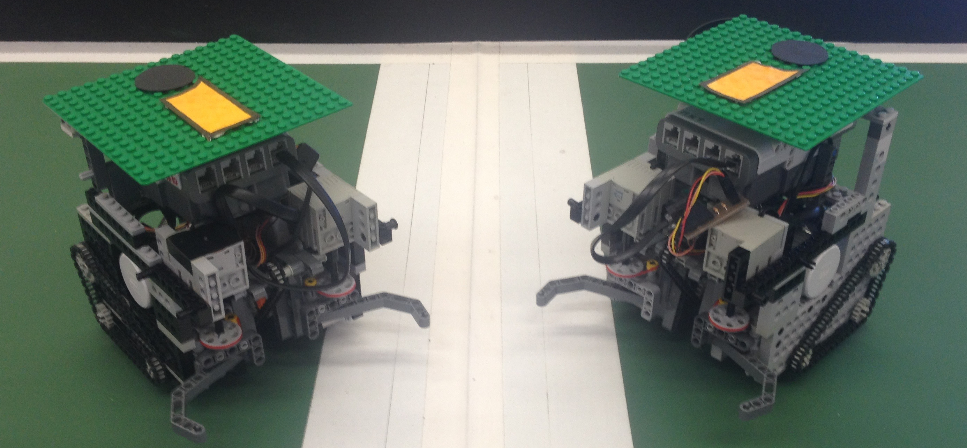
The Robots

Slide 5
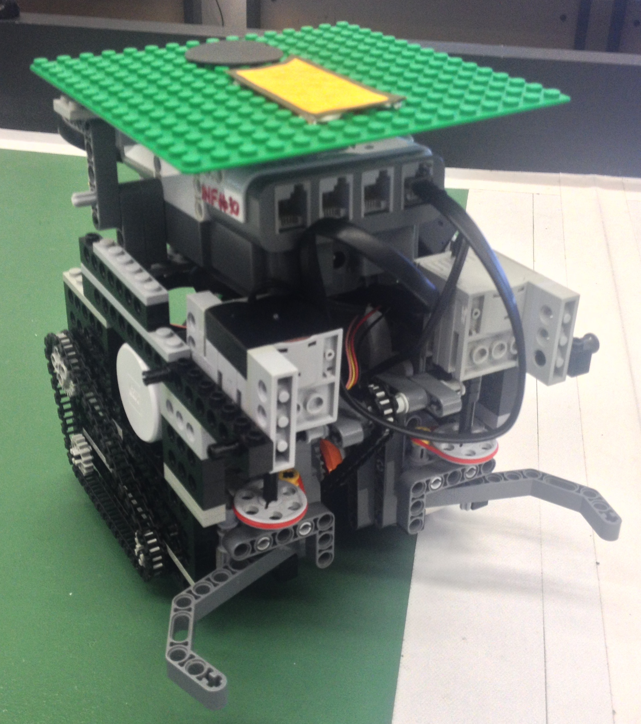
The Robots
Sttuffgnfgj

Slide 6
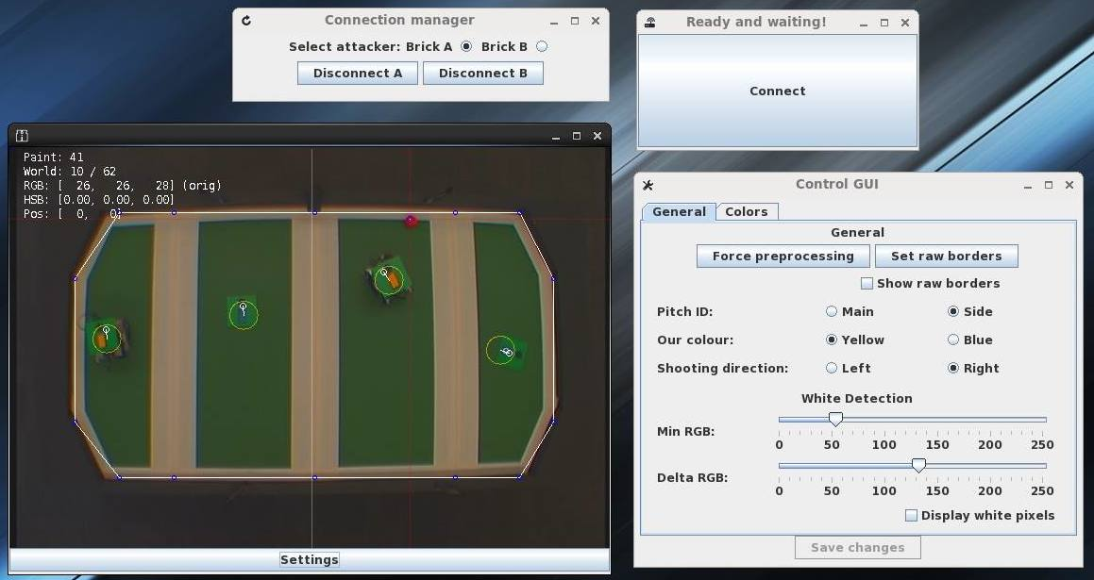
The Vision System
We designed a functional GUI to streamline the process of connecting to the robots and running the vision system.
With a setting window to fine-tune colour detection on the fly.
We integrated the GUI with the Bluetooth TCP connection.

Slide 7
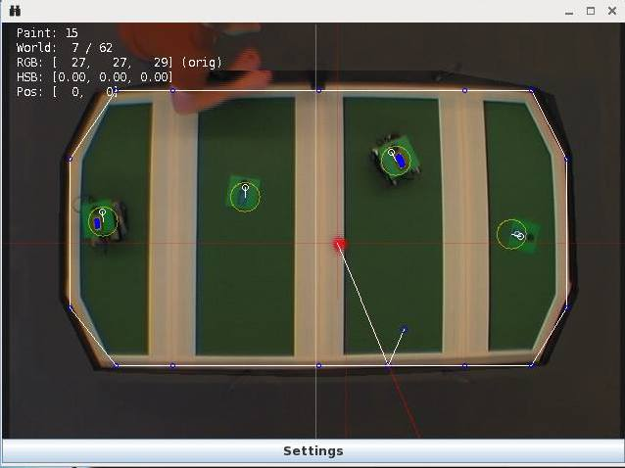
Features of the vision system
Automatically determines pitch boundaries to optimize processing.
Separate Threads to update world state and draw the state.
Ball rebound prediction.
K-Mean plate detection
Distance-to-camera distortion correction.
Notes:
The Convex Hull code cuts out everything in the image we don’t need to look at, optimizing the vision processing, also calculates the section boundary points.
By updating at 62x/s and only drawing at 15x/s we further speed up the system.
The Vision can predict where the ball is going to be after a rebound so the robots can defend against attacks effectively even with sneaky attack methods.
System uses a fast K-means method to accurately determine green plates against a a green pitch and ignores rogue outliers.

Slide 8
High Points
Notes:
First of all, I’ll take you through some of the high points of the project for out team. Then I’m going to show you some of the iterations we underwent throughout the SDP process and how the system evolved from commit 1, to commit 554 (change as necceary).
Then I’m going to give you an insight into how and why we worked so well together as a team.

Slide 9
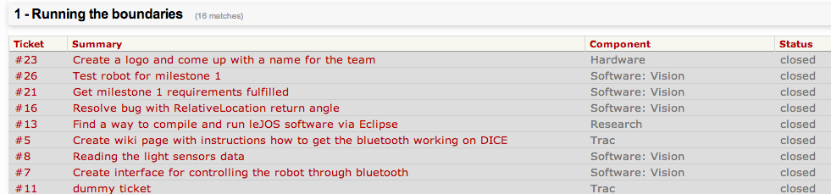
Project Management

